Slide 1

BLOCKCHAIN
Prof. Sunitha R
Department of Computer Science Engineering

Slide 2

BLOCKCHAIN
Types of Blockchain
Prof. Sunitha R
Department of Computer Science Engineering

Slide 3
BLOCKCHAIN
Learning Content
Discuss about the various types of blockchain network and how each suitable for particular real time application.

Slide 4
BLOCKCHAIN
Types of Blockchain
Private
Public
Hybrid
Consortium

Slide 5
BLOCKCHAIN
Public Blockchain
Public blockchains are permissionless blockchains where anyone can join the network and read and write to the ledger.
Any user can develop and add smart contracts to blockchain without any intervention forced by developers.
It bring complete decentralization.
Notes:
Public blockchains are permissionless blockchains where anyone can join the network and read and write to the ledger. Such blockchains allow users from anywhere in the world to interact with the blockchain and submit or read transactions as far as they are connected with the blockchain network. In a permissionless blockchain, any user can develop and add smart contracts to blockchain without any intervention forced by developers.
Permissionless blockchains bring complete decentralization , which means that there exists no central authority to edit the ledger state or make any kind of modifications to the network protocols. This makes the system robust against a single point of failure with distributed trust.

Slide 6
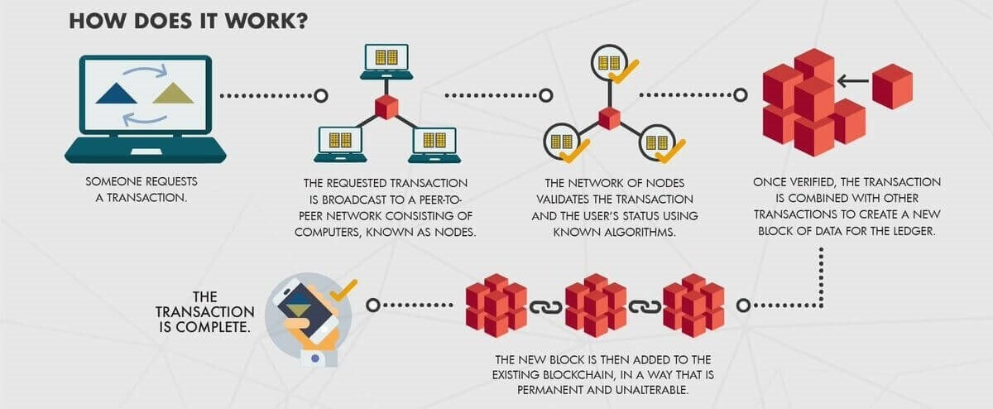
BLOCKCHAIN
Public Blockchain
Notes:
Blockchain has enabled a new wave of technological progress that can disrupt many industries and systems before us. The ability to seamlessly secure data in a fully transparent and verifiable way through a decentralized system has captured the attention of people and businesses alike, prompting many to jump on board the bandwagon in search for a better alternative.
Transactions on a public blockchain are publicly transparent and immutable (data cannot be tampered with or altered in any way) but this could pose as a barrier for businesses that want to keep customers’ data confidential. On the other hand, private blockchains are much faster and scalable, but it is more centralized and could be prone to manipulation.

Slide 7
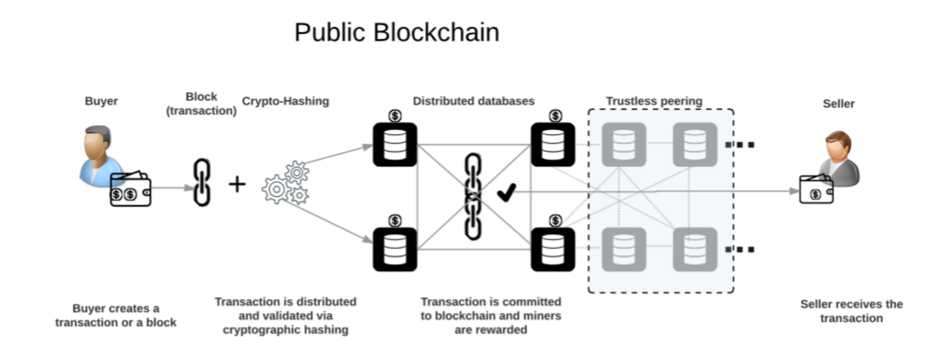
BLOCKCHAIN
Public Blockchain
Notes:
Public blockchain networks like Bitcoin, Ethereum, LiteCoin, Ripple etc., are based on trustless peering. This means any system with public IP, beefy hardware and highspeed internet can join these networks and synchronize the entire blockchain history. Public blockchain reaps its benefits in the areas where network needs decentralization with anonymous access to ledgers. With the addition of each node, the complexity of cryptographic hashing increases and will lead to additional CPU usage, power, and transaction time, in order to arrive at a consensus.

Slide 8
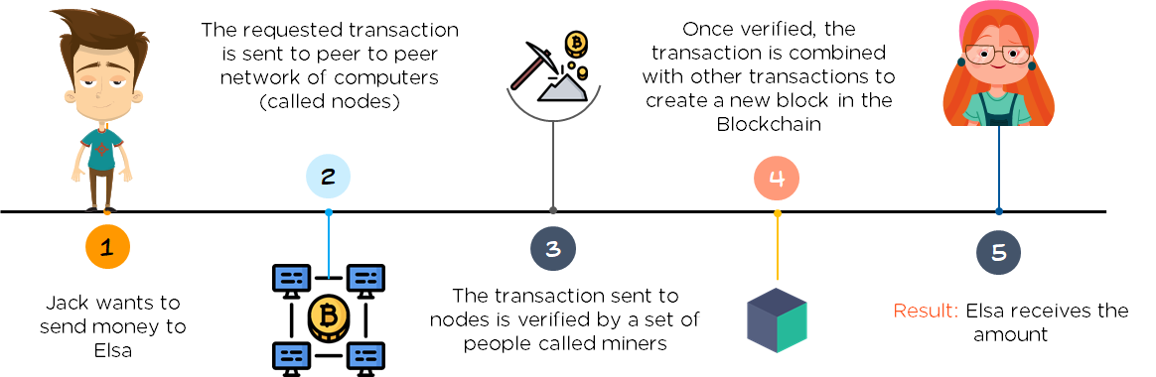
BLOCKCHAIN
Bitcoin Public Blockchain
Notes:
Public blockchain networks like Bitcoin, Ethereum, LiteCoin, Ripple etc., are based on trustless peering. This means any system with public IP, beefy hardware and highspeed internet can join these networks and synchronize the entire blockchain history. Public blockchain reaps its benefits in the areas where network needs decentralization with anonymous access to ledgers. With the addition of each node, the complexity of cryptographic hashing increases and will lead to additional CPU usage, power, and transaction time, in order to arrive at a consensus.

Slide 9
BLOCKCHAIN
Private Blockchain
Do not allow any user to freely join the network and read or write to the ledger.
It maintains an access control mechanism
Users identity is known to everyone, but transactions are only visible to those who have appropriate permission.

Slide 10
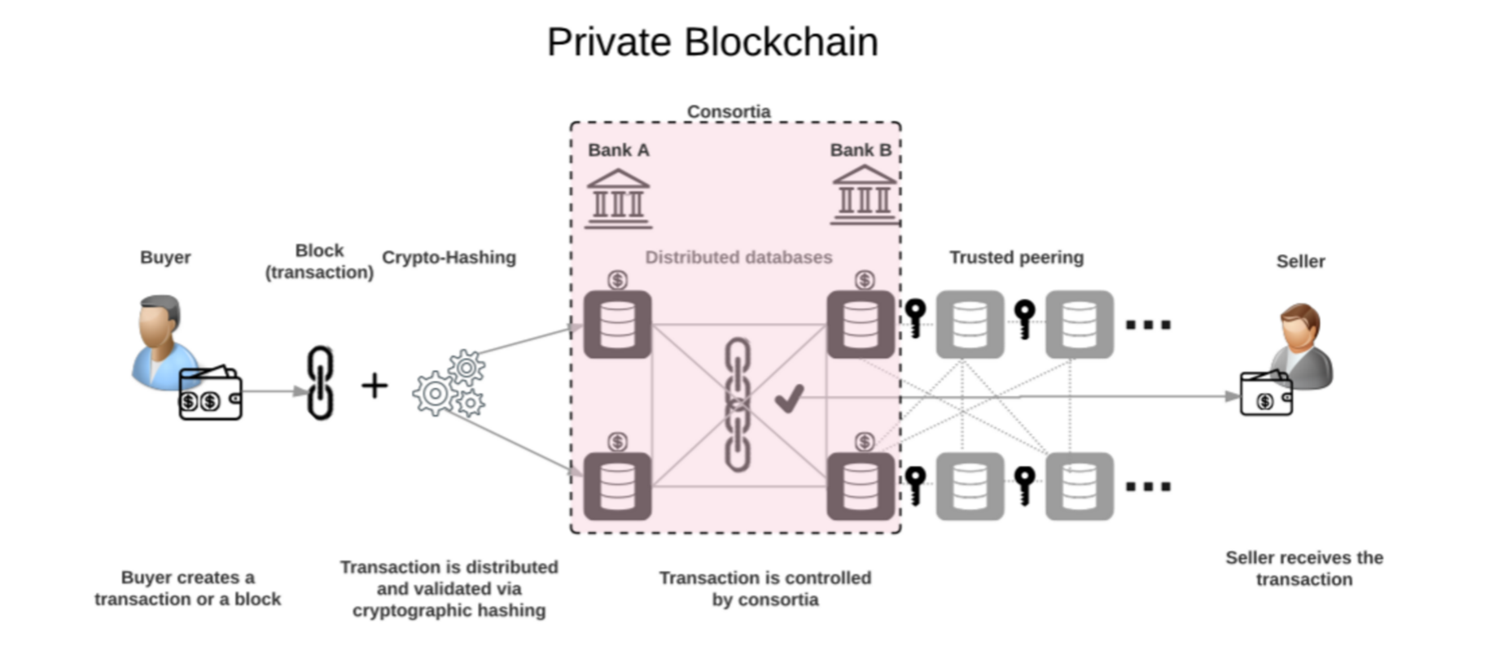
BLOCKCHAIN
Private Blockchain

Slide 11
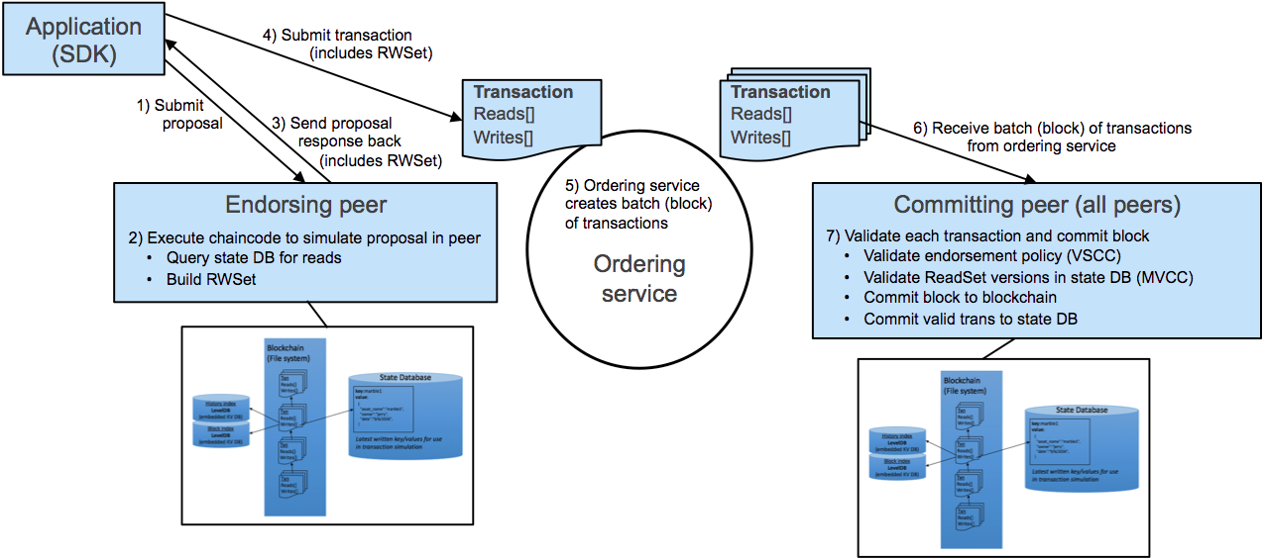
BLOCKCHAIN
Hyperledger Private Blockchain
Notes:
Hyperledger Fabric 1.0 was developed by a Hyperledger consortium, Joining the consortium will allow the member corporations to join the Hyperledger global network and allow them to collaborate with industry experts across the globe. IBM currently offers a Beta program to get started on Hyperledger Fabric.
Hyperledger Fabric’s modular architecture processes a transaction in three phases. First, a transaction from DAPP (Distributed blockchain app) goes through “endorsing peers.” Then this module processes the read-only transactions, and builds datasets by executing custom business rules via smart contracts. These datasets are transformed into blocks by the ordering service. Finally, “committing peers” validate and commit the block to the ledger.

Slide 12
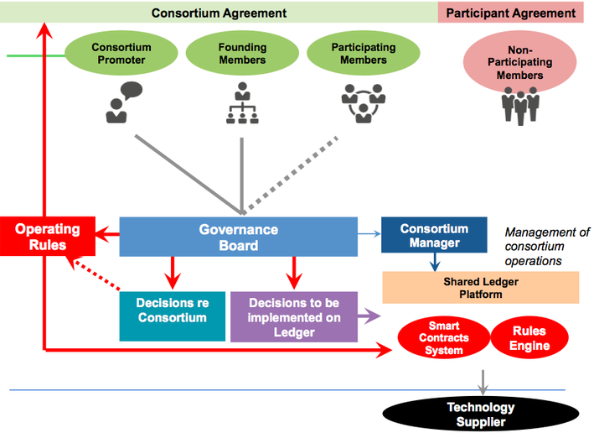
BLOCKCHAIN
Consortium Blockchain
Notes:
The consortium blockchain is a hybrid between the ‘low-trust’ offered by public blockchains and the ‘single highly-trusted entity’ model of private blockchains.
Its characteristics are the following:
the consortium is permissioned: it’s not for everyone, but for a predetermined group of enterprises;
it is semi-decentralized: under the supervision of members of the limited group;
it has a multi-party consensus: all operations are verified by special pre-approved nodes, not by the world community, like in bitcoin blockchain.
The governance roles and operating rules emergence in consortium blockchain are exhibited in the picture below.
This slide shows how a consortium forms. Someone (consortium promoter) decides that there is a reason for the consortium to form. Once this happens founding members and participation members join with different benefits or tiers of benefits based on the operating rules of the consortium agreement which are decided by a governance board. These rules include such things as legal and structural decisions of the consortium as well as decisions which are to be implemented on the shared ledger based on a specific technology implemented by the consortium promoter with input from all of its members. The smart contract system and the rules engine have ensure consistency between real world contracts and smart contracts and as is shown below this is done in both private and public models because "code is king" does not hold up.

Slide 13
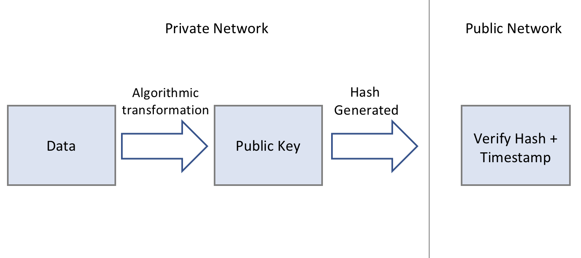
BLOCKCHAIN
Hybrid Blockchain
Notes:
Hybrid blockchain offers the benefits of both public blockchain and private blockchain.
Firstly, hybrid blockchain consists of the public blockchain (that all participants are a part of) and a private network (also referred to as a permissioned network) that restricts participation to those invited by a centralised body.
Secondly, this private network generates the record (hash) of transactions which is stored and verified on the public blockchain. The benefits of the private blockchain include faster transaction speeds, privacy of the data/ content and a centralised control over providing access to the blockchain.
Hybrid provides an enterprise-ready blockchain solution that is much better suited to highly regulated enterprises and governments as it enables them to have the flexibility and control over what data is kept private versus shared on a public ledger. Coupled with the operational needs of faster transaction times, security and auditability features that are not suited to public blockchains.

Slide 14
BLOCKCHAIN
Supplementary readings
https://www.blockchain.com/
https://blockchainhub.net/blockchains-and-distributed-ledger-technologies-in-general/
https://hyperledger-fabric.readthedocs.io/en/release-2.2/whatis.html
https://ethereum.org/en/
Notes:
Public Blockchain Ledger
This blockchain is totally open to all and anybody can join the system. Each member on the chain has full power to access, read and write transactions. Since it is decentralized and wholly distributed, every node gives verification to approve any transaction. Data can’t be altered or manipulated once it is placed on the block. Public blockchains are also called permissionless blockchains.
Being totally open to everyone is the biggest drawback of this type of ledger, since it offers complete transparency with little privacy. Time taken to reach consensus by the network is high because of the numerous nodes present, therefore resulting in high computational power. Bitcoin, Ethereum, etc are popular examples.
Private blockchain Ledger
Also called permissioned blockchains, they have limitations on who is participating in the network. A user is granted access only by the network initiator or by a predefined set of rules. Once a user is given entrance to the network, it can perform the same duties as that of other users. Again, the degree of permissions is decided by the one who initiated the network.

Slide 15
THANK YOU
Sunitha R
Department of Computer Science Engineering
sunithar@pes.edu
+91 80 6666 3333 Extn 721

